Slide 1


PERSUASIVE SPEAKING
Week 12
Lecture 1
Coursepack Pg. # 251-257

Slide 2
Inciting Action through Incentives Incentive: positive reinforcement/reward for completing a specific action
To satisfy unmet needs – physical/social/psychological
Incentives that outweigh costs – “you will get more than you gave”

Slide 3

Organizational Patterns
Statement of Reasons / Topical Reasons
Comparative Advantages
Criteria Satisfaction
Refutative
Problem – Solution
Problem – Cause – Solution
Motivated Sequence

Slide 4

Statement of Reasons / Topical Reasons
Proposition: Government should impose traffic rules with more strictness
Reason 1 (second strongest): Decrease time of travel because of less traffic jams
Reason 2,3,4: _________
Reason 5 (strongest): Less road accidents
Proposition supported by facts arranged in a meaningful order
Strongest reason = Last
Second strongest reason = First

Slide 5

Comparative Advantages
Proposition: Nook is more advantageous than the Kindle.
Main Points:
1. The Nook allows owners to trade and loan books to other owners or people who have downloaded
the Nook software, while the Kindle does not.
2. The Nook has a color-touch screen, while the Kindle’s screen is black and grey and non-interactive.
3. The Nook’s memory can be expanded through microSD, while the Kindle’s memory cannot be
upgraded.
Compare two solutions and prove one carries more value than the other

Slide 6

Criteria Satisfaction
Presents a criteria for the solution that the audience should lean towards.
Shows how your proposed solution/item/idea/belief satisfies that criteria
Proposition: Donate to ABC charity
Define criteria for recognizing a good charity:
Trustworthy
Transparent
Flexible
Show how ABC charity fulfills these criteria and thus should be supported

Slide 7

Refutative
Proposition: Education should be free up to 5th grade.
(Discuss counter arguments and refute them)
e.g.
Opponents say that free education would cause a dent in the economic situation of our country – I say it’ll benefit us in more ways by generating a greater amount of educated youth who can service the country
and so on…
Tackle (refute) counter arguments while supporting your point
Most preferable when the audience is opposed to your proposition

Slide 8

Problem – Solution
Presents a problem – recommends a solution
General Outline:
X is a problem
Y can solve X
Y is the best possible solution for X

Slide 9
Problem – Cause – Solution
Presents a Problem – Discusses the causes for said Problem – Proposes a Solution
General Outline:
X is a problem
A, B and C are causes
Y can tackle these causes and solve X

Slide 10
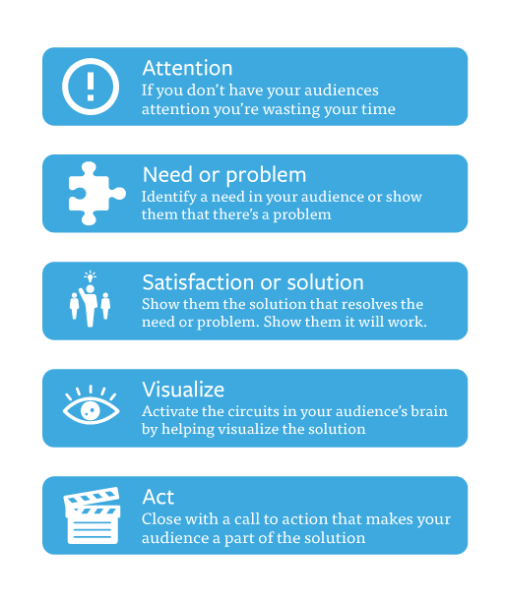
Motivated Sequence
Five-point sequence designed to appeal to the audience with both problem – cause patterns as well as motivational incentives

Slide 11
Motivated Sequence Sample
ATTENTION
When was the last time you saw a dog chained to a tree in a neighbor’s yard, heard about a puppy mill in your town, or went into a pet store only to find dogs and cats for sale?
I work with the Morris County Animal Protection Group, and I would like to share some ways in which you can help prevent these travesties.
First, I will describe some of the major problems in Morris County, and then I will tell you how you can get involved.

Slide 12
Motivated Sequence Sample
NEED: Many animals in Morris County are abused and neglected.
There are too many stray animals that are neither spayed nor neutered, resulting in an overabundance of cats and dogs.
These animals often cannot find enough food to survive, and the local shelter cannot accommodate such high populations.
The cost of local spay/neuter programs is too high for our agency to handle.
A.

Slide 13
Motivated Sequence Sample
SATISFACTION: Raising $1 million for the Morris County Animal Protection Agency can effectively solve these problems.
We could afford to spay or neuter most stray animals.
Obtained animals could be fed and accommodated until a home can be secured for them.
Additionally, we could subsidize spay/neuter costs for local citizens.

Slide 14
Motivated Sequence Sample
VISUALIZATION: Imagine what we can do for our animals with this money.
What will it be like if we can carry out these actions?
What will it be like if we cannot do these things?

Slide 15
Motivated Sequence Sample
ACTION: Donate to the Morris County Animal Protection Agency.
If you want to help protect the many struggling stray animals in Morris County, make a donation to our organization.
Your donation will make a real difference in the lives of our animals.
We cannot effect real change for the animals of our county without each and every one of you.

